Slide 1


To our class

Slide 2
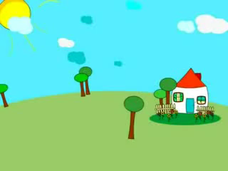

Slide 3

Lucky number
1
2
3
4
5
6

Slide 4

1. What does she do in her bedroom?
She sleeps and dreams.

Slide 5

2. List at least 3 things in her kitchen?
Forks, knives , plates , glasses

Slide 6

LUCKY NUMBER

Slide 7

4. How many rooms are there in her house?
There are four.

Slide 8

6. Does she watch TV in her bedroom?
No, she doesn’t.

Slide 9

3. Where does she wash her hand?
In the bathroom.

Slide 10
Period 10: Unit 2: MY HOME
Lesson 2: A Closer look 1

Slide 11
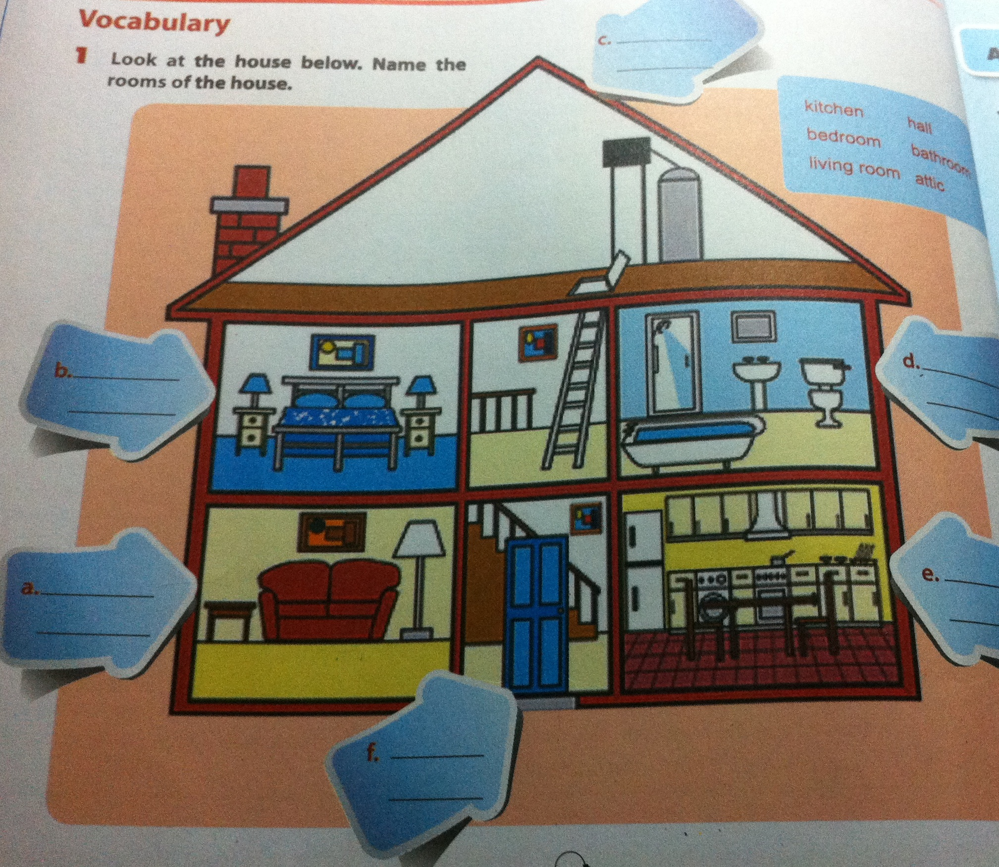
1. Name the rooms of the house.
attic
bedroom
bathroom
Living room
kitchen
hall

Slide 12

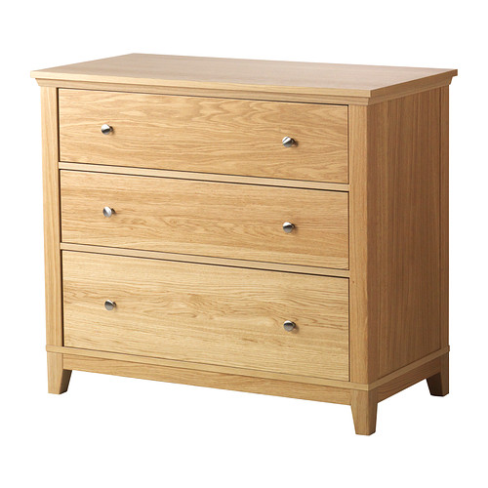
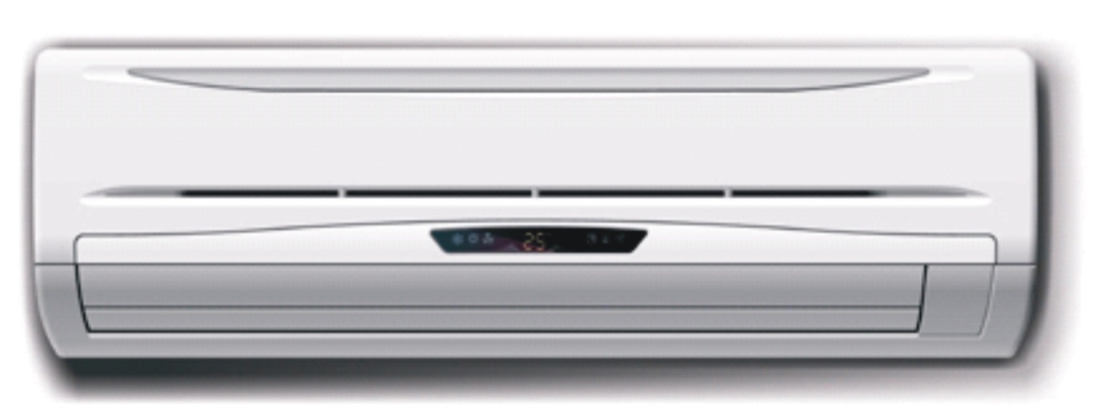
New words
1. attic (n):
Mái hiên
2. hall (n):
Hành lang
3. chest of drawer (n):
Ngăn kéo
4. air-conditioner(n):
Máy điều hòa
5. ceiling fan (n):
Quạt trần

Slide 13
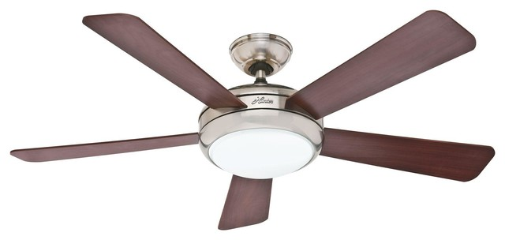
Mái hiên
Hành lang

Slide 14

2. Name the things in each room. Use the word list below:
living room bedroom kitchen bathroom hall attic | lamp toilet bed picture bath cupboard chest of drawers fridge poster chair air-conditioner | wardrobe sink sofa television table dish washer desk cooker light microwave ceiling fan

Slide 15


Slide 16

/ s/:
c, k, f, p, t,
s
/ iz/:
s, x, sh, ch, z, c, g
/ z/:
Còn lại

Slide 17
5. Listen and repeat.
lamps
posters
sinks
fridges
tables
wardrobes
toilets
beds

Slide 18
6. Listen again and put the words in the corect column.
lamps
posters
sinks
fridges
tables
wardrobes
toilets
beds
/ z/ | / s/ | /iz/
posters
lamps
fridges
tables
sinks
wardrobes
toilets
beds

Slide 19

Homework
Learn by heart all the new words.
Write words with the sounds: /s/ / iz/ and / z / in patr 7.

